Slide 1
IELCCP Consortium Meeting #1
August 14, 2019
Purpose:
To establish a working consortium of county leads who will guide their COEs and school districts in the process of increasing inclusion opportunities for young children (birth to five years) with special education needs, with a particular focus on children with significant disabilities.

Slide 2
IELCCP Consortium Meeting #1
August 14, 2019
Outcomes:
To have active engagement in discussions and activities which will lay the foundation for the grant components; and
To develop individualized next-step action plans for individual counties to move forward in increasing birth to 5 inclusion opportunities in their counties

Slide 3
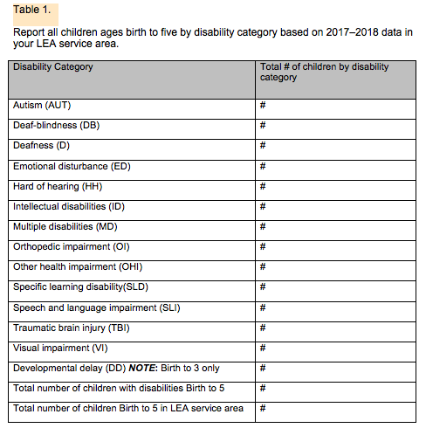

Slide 4
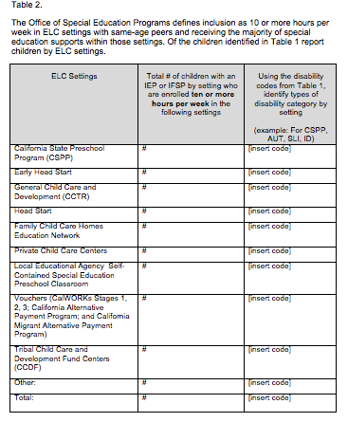

Slide 5
