Slide 1
NAPA COUNTY
Data Network
WHY DATA MATTERS!
2019

Slide 2
Data Systems
Data Flow and Content
CALPADS
Timeline
System Linkages
School Improvement & Accountability
Data Ethics
WHY DATA MATTERS!

Slide 3
WHY DATA MATTERS!
Data Quality & Integrity
Data Champions take pride
in the work to ensure that all data is input and maintained consistently & accurately.
School leadership can trust the data to make decisions that will ultimately improve student outcomes.

Slide 4
WHY DATA MATTERS!
What is a S I S ?
Student Information System
Local systems that enable schools to maintain, manage and access complete student records. They are designed with diverse application potentials ranging from simple management of students’ records to management of all student-related functions as well as administrative functions.
Reporting local data to the state requires local staff to extract SIS data and upload it into CALPADS (the state data system) on a regular basis. This process is not automatic!
Administrative Data
SIS
Student Data
Staff Data

Slide 5
WHY DATA MATTERS!
What is SEDS ?
Special Education Data System
Special Education Information System (SEIS), hosted by San Joaquin Office of Education
NEW Connection to CALPADS via API
Automated process to submit data for Student with Disabilities from SEIS to CALPADS
Special Education student profiles
Special Education student services
Reporting local data Special Education data to the state requires local staff to extract SEIS data and send it to CALPADS via API on a regular basis. This process is not automatic!
Transition intended to improve data quality for Students with Disabilities

Slide 6
WHY DATA MATTERS!
What is C A L P A D S ?
California Longitudinal Pupil Achievement Data System
Data collected throughout the school year as students enroll and exit
Statewide data systems matches
Direct Certification for Free + Reduced Price Meals and Foster Youth matches
Specific data collections - scheduled submissions
Census Day and End of Year
Data reported through CALPADS is directly related to funding for local programs

Slide 7
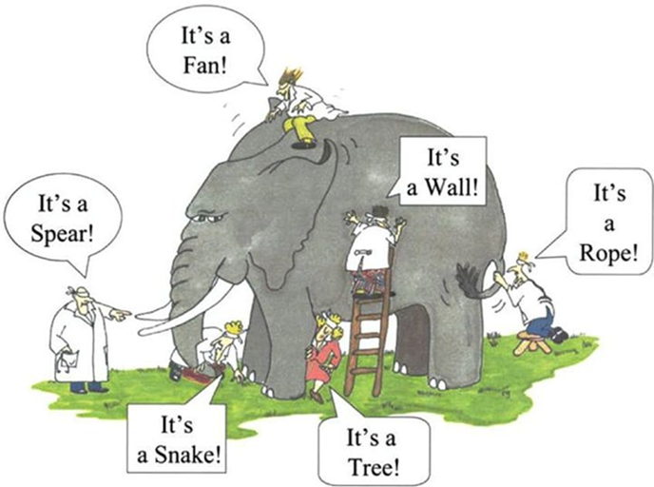
WHY DATA MATTERS!
Build shared ownership and collaboration around data governance
Improve data quality for teachers, school leaders and central office in service to students
Create processes proactively to ensure accuracy of data
1
2
3
Preparing our Teams
Establish a data governance structure to facilitate overall management of data availability, usability, integrity, quality and security:
Leadership vision
Roles and responsibilities
Policies and process
Establish a Data Team
Build processes to support a positive data culture
Communicate regularly for high accountability across organization
Notes:
The Special Ed coordinator is likely the SME on SEDS population
SELPA Director has SELPA Approval role . CDE issues the SELPA account.
LEA Admin creates account or adds their org to an existing account

Slide 8
WHY DATA MATTERS!
CALPADS
Data Coordinator
Special Education Data Coordinator
SELPA
Populates student profile data in CALPADS
Manages access to CALPADS
Approves CALPADS data
Works with SIS vendor
Works with LEA staff to ensure SIS data quality and reporting processes
Populates SWD data into SEDS and transfer to CALPADS via API
Resolves validation errors
Reviews reports related to SWD
Works with SEDS vendor
Intermediary with SELPA Director and CALPADS Coordinator
Manage SEIS
Reviews reports related to SWD
Approves SWD data in CALPADS
Local staff input student data in SIS
Local staff input student data in SEIS
Notes:
The Special Ed coordinator is likely the SME on SEDS population
SELPA Director has SELPA Approval role . CDE issues the SELPA account.
LEA Admin creates account or adds their org to an existing account

Slide 9
WHO’S ON YOUR DATA TEAM
CALPADS LEA Staff
Data population and report certification
Special Education Staff
Special Education data population and report certification
Ensuring that the State Course Code and associated attributes in the student information system (SIS) accurately reflect the course content
Verification of course and staff assignment information in CALPADS reports
Curriculum & Instruction Staff
Human Resources Staff
Provide staff demographic, job classification data, and non-classroom based assignments for staff
Verification of staff data in CALPADS reports
Credential Analysts
Ensuring staff have the appropriate authorizations for their assignments prior to the start of the school year, including local assignment options
Verification of staff assignment data in CALPADS reports
Notes:
Build shared ownership and collaboration around data governance
Improve data quality for teachers, school leaders and central office in service to students
Create processes proactively to ensure accuracy of data
Preparing our Teams:
Establish a data governance structure to facilitate overall management of data availability, usability, integrity, quality and security:
Leadership vision
Roles and responsibilities
Policies and process
Establish a Data Team
Build processes to support a positive data culture
Communicate regularly for high accountability across organization

Slide 10
WHY DATA MATTERS!
Post-
Grad
CTE
Which
students are included?
Collects longitudinal data about students from
first enrollment to final exit
Pre-Kinder
Graduation
How are
students identified?
Public, K-12
Pre-K Special Ed, optional for General Ed.
Statewide Student Identifier (SSID)
Private School Special Education students will be included
NPS, K-12
Adult Education
Private School

Slide 11
WHY DATA MATTERS!
LOCAL DATA SOURCES
Where does the data come from?
Student Information System (SIS)
NVUSD, Calistoga, Howell Mountain, St. Helena use Aeries
NCOE uses PowerSchool
Pope Valley uses Schoolwise
Registration
Teachers, Administrators, Programs
& Discipline
Nutrition Services
Course
Information
Special Ed. System
(SEIS)
Human Resources
(Digital Schools)
Attendance

Slide 12
WHY DATA MATTERS!
Where does the data come from?
CALPADS
User-generated reporting
Local Student Information System
(SIS)
CA Department of Social Services
User-generated reporting via API
CalFresh
CalWorks
CWS/CMS
Special Ed. System
Student Testing
(CAASPP, ELPAC)
Special Ed data will be submitted to CALPADS from SEIS via API

Slide 13
WHY DATA MATTERS!
FALL
Census Day
END OF YEAR
Full
Year
What
data is collected?
Enrollments & Exits
Demographics
When?
Program Eligibility
& Participation
English Language
Acquisition Status
CTE
CTE
Courses
Enrollment
Completion
SwD
Absenteeism
Grad
Dropout
Staff
Discipline
Grad
Dropout

Slide 14
CALPADS - Data Collection Schedule
Fall 1
Fall 2
EOY 1
EOY 2
EOY 3
EOY 4
As of Census Day
Due December
As of Census Day
Due March
July 1 - June 30
Due August
July 1 - June 30
Due August
July 1 - June 30
Due August
July 1 - June 30
Due August
Enrollment Counts
Student Course Enrollments
Course Completions for Grades 7-12
Program Participation
Student Discipline
Incidents
Offenses
Results
(including SwD)
SwD
Previous Year
Grads and Drops
SwD Services
Staff Assignments and FTE
LCFF Eligible Students
CTE Participants, Concentrators, Completers (Perkins Report)
Homeless Students
SwD Postsecondary Status
English Language Acquisition Status
Student Absence Summary
Cumulative Enrollment
English Learner Education Services
Immigrant Counts
SwD
Postsecondary Status CTE
SwD Services
Notes:
Handout

Slide 15
CALPADS - Data Collection Overview
CALPADS
Student Profile
CALPADS
Discipline
CALPADS
Special Ed.
Files
Enrollment
Student Incident
Special Ed. Program
Demographics
English Language Acquisition Status
Student Incident Result
Student Services
Student Programs
Student Offense
Post School Outcomes
Courses
Enrollment & Completion
CTE concentrators & completers
Attendance
Post School Outcomes CTE
Notes:
The Student profile Data Population that is the basis for Fall 1 is the building block for the rest of the data reporting requirements in CALPADS. The student profile, the records related to our students determine the services, course enrollment, program eligibility and participation, CTE participation, exemptions and expectations for absence and attendance. These are just a few of the examples of how the record types initially submitted during the Fall 1 data collection are relevant or determine the data in future submissions throughout the year.

Slide 16
CALPADS - Data Collection Overview
CALPADS
Student Profile
Student Programs should be updated regularly
throughout the year regardless of submission period!
PROGRAMS collected FALL
PROGRAMS collected EOY
Enrollment
CODE | PROGRAM | TYPE
181 182 | Free Meal Reduced Meal | Federal
127 | Gifted and Talented (GATE) | Federal
191 | Homeless | Federal
185 | Transitional Kindergarten (TK) | State
135 | Title I Part C Migrant | State
300 -306 | English Learner Programs | State
CODE | PROGRAM | TYPE
122 | Title I Part A Basic Targeted | Federal
174 | Title I Part A Neglected | Federal
191 | Homeless | Federal
192 | Armed Forces Family Member | Federal
101 | 504 Accommodation Plan | State
108 | Opportunity Program | State
113 | California Partnership Academy | State
162 | Pregnant or Parenting Programs | State
185 | Transitional Kindergarten | Stae
Demographics
English Language Acquisition Status
Student Programs
Courses
Enrollment & Completion
CTE concentrators & completers
Attendance
Post School Outcomes CTE
Notes:
This slide list all Program codes that are collected throughout the year. Although, some programs are collected in Fall 1 and some in End of Year, it is important to report/update a student’s eligibility or participation in CALPADS as soon as the information is available.

Slide 17
BEST PRACTICES - CALPADS Data Submissions
What data is required for ongoing data submissions?
Reports (batch files, transactions) or online maintenance completed on daily or weekly, depending on local processes (more frequently during testing times)
Conduct online maintenance as needed
SENR
(Student Enrollment Data Submission)
SENR reports include enroll and exit date info for all students.
Basic demographic info to match the student to their existing record in CALPADS
SINF
(Student Information Data Submission)
SINF include ALL student demographic updates
Detailed student demographics
SPRG
(Student Program Data Submission)
SPRG reports include special programs that students are enrolled in.
SELA
(Student English Language Acquisition Submission)
SELA includes student’s primary language and English Language acquisition status (ELAS) and date.
Status is determined upon enrollment and then updated by district-specific requirements
SPED + SSRV
(Students w/ Disabilities
and their services)

Slide 18
BEST PRACTICES - CALPADS DATA SUBMISSIONS
How is your local data reported to CALPADS?
Batch Files
Batch file processing allows for one or more students data to be uploaded in a single transaction. Batch file submissions are the most efficient way to manage a large number of students and import SIS data into CALPADS.
Enter data into SIS or excel, then upload the extract using the CALPADS platform
2. Online Maintenance
Online maintenance is performed for only one student at a time. The data is entered manually through a series of screens. This process can clog the system and be more time consuming.
Edit data manually in CALPADS portal
Do you know who uploads your local data

Slide 19
CALPADS - Scheduled Data Submissions
Information Day/ Census Day
First Wednesday in October: 10/2/19
LEA Deadline 12/6/19
SELPA Deadline
12/20/19
Final Deadline
1/24/20
Grad Cohort Snapshots Available
4/13/2020
TOMS Offline
Initial ELPAC Online Assessment
7/1/2020
FALL 1
Submission Window
Amendment Window
2019
OCT NOV
DEC JAN
FEB MAR
APR MAY
JUN JUL
AUG SEP
2020
FALL 2
Submission Window
EOY
Submission Window
Snapshots Available
1/7/2020
Final Deadline
3/20/2020
Snapshots Available
5/11/2020
LEA Deadline
7/31/2020
SELPA Deadline
Cohort Deadline
8/28/2020
Notes:
Handout
Fall 1 completer and dropouts are determined from exits between 8 16/2018 – 8/15/2019.
Lost transfer dropouts are collected from 8/16/2018 – 5/14/2019.
For active enrollments, only students enrolled as of Census day (the first Wednesday in October) are counted.
No show dropouts have a different exit date range than other types of dropouts. No Show dropouts are students who completed the previous school year with an exit date between 5/15/2018 - 8/15/2018 and did not re-enroll by 8/15/2018.
If you happen to be in CALPADS, note that these ranges currently align with those used for ERD anomaly detection so the ERD anomaly screen can be used to check the date ranges for a specific year.

Slide 20
KEY DATES - ASSESSMENTS
SBAC, CAA, CAST, CSA
Opens 1/2020
ELPAC Summative Opens
Opens 2/2020
Initial ELPAC Online
Opens 7/2020
FALL 1
Submission Window
Amendment Window
2019
OCT NOV
DEC JAN
FEB MAR
APR MAY
JUN JUL
AUG SEP
2020
FALL 2
Submission Window
EOY
Submission Window
CA Alternative Assessment for Science
9/2020
Data should be updated regularly during testing times! Doing so will keep TOMS up-to-date for testing coordinators.
Notes:
https://www.cde.ca.gov/ta/tg/ai/documents/assessmentstimeline.pdf
Change to Submission of EL and IFEP Statuses
On July 1, 2020 when the English Language Proficiency Assessment for California (ELPAC) becomes an online assessment, in order to assess potential English learners (EL) with the Initial ELPAC, students must have:
An enrollment record with the student’s actual start date (expected first day of school)
An Student English Language Acquisition (SELA) record for the student with:
English Acquisition Status (ELAS) of “TBD”
ELAS Start Date of the current date
Primary language other than English or American Sign Language
An Student Information (SINF) record with the student’s address, IF THE LEA wants the student address to be printed on the Student Score Report (SSR)
When student completes ELPAC:
EL and IFEP statuses will be designated directly from ETS>TOMS>CALPADS
LEAs will no longer be able to submit EL or IFEP Code in ELAS
In order for EL students to be tested with the Summative ELPAC, they must have an ELAS of EL
Therefore, for this coming Summative ELPAC window (February 1, 2020 though May 31, 2020), it is critical that LEAs update students’ TBD statuses in CALPADS prior to and during the ELPAC Summative window; students must have an ELAS of EL to show up in TOMS for Summative ELPAC testing – REMEMBER it takes 48 hours to update.
Once the Initial ELPAC goes online, LEAs will no longer have the option of testing students during the summer using the paper pencil test, and then uploading the results in the Local Scoring Tool once the student enrolls in the fall
LEAs will have to determine whether to pre-enroll students and assess those students in the summer, or wait and assess students in fall when students actually enroll and show up in school
To mitigate multiple identifier (MIDs) anomalies, it should become part of LEAs’ local processes to first look to see whether a new student already has an ELAS in CALPADS, or an Initial ELPAC score in TOMS before requesting a SSID
Change to Submission of Student Test Settings
Beginning in 2020-21, LEAs will submit student test settings to CALPADS using the Student Test Settings (STSE) File for students who require designated supports and accommodations to the California Assessment of Student Performance and Progress (CAASPP) and ELPAC
Designated supports are available to all students when determined for use by an educator or team of educators (with parent/guardian and student input, as appropriate) or specified in a student’s individualized education program (IEP) or Section 504 plan
Accommodations must be permitted on CAASPP tests to all eligible students if specified in the student’s IEP or Section 504 Plan
The STSE file may be uploaded from the SEDS through the API to CALPADS and/or from the SIS to CALPADS

Slide 21
NEW FOR 2019-20: Assignment Monitoring
Cal-SAAS Process Timeline
Information Day/ Census Day
First Wednesday in
October
Late April
Cal-SAAS outputs questionable assignments
Monitoring Authority (usually COE)
30 days to send final justifications to CDE
Early April
Data sent to CTC
OCT NOV
JAN
DEC JAN
FEB MAR
APR MAY
JUN JUL
AUG
FALL 2
State and Course Data Certified
LEAs have 60 days to justify questionable assignments
Misassignment file sent to CDE
Data Population
December
Snapshots Available
January
Fall 2 Deadline
3/20/2020
Notes:
Support for New Assignment Monitoring Process
To facilitate the use of CALPADS Fall 2 course data for assignment monitoring, the course codes and CRSE file were significantly modified
The course codes have been simplified (fewer more general course codes) and course attributes (data elements) have been added
To prepare for these changes:
The CDE provided an overview of the changes in the April 2019 CIM
CDE (CALPADS and program office staff) and CTC conducted over 30 regional trainings, and have held weekly Office Hours
CDE and CSIS support:
Training materials are still available here: https://padlet.com/bjauregu/assignmentmonitoring
Webinars of the trainings can be provided here: https://www.cde.ca.gov/pd/ee/peatprofdev.asp
CALPADS File Specifications and CALPADS Code Set are posted here: https://www.cde.ca.gov/ds/sp/cl/systemdocs.asp
CSIS Fall 2 training will include the changes to the CRSE and codes
Respond to questions:
For course mapping questions: TLPO@cde.ca.gov
For CALPADS questions submit a Service Desk ticket to: calpads-support@cde.ca.gov
CTC is:
Updating the Administrator’s Assignment Manual
Developing a CalSAAS Manual (to be ready for User Testing)
Developing a CalSAAS web pages on the Credential Information Guide (CIG) website
Developing CalSAAS Frequently Asked Questions (FAQs)
Developing additional Assignment resources
Curriculum & Instruction staff, Credential Analysts, Human Resources Staff, Special Education and CALPADS staff should use Mapping Template tool (on padlet) to map local courses to new state courses and select attributes
Notable Changes:
Course Codes have been simplified, with fewer more general codes
Course attributes have been added to define specifics, called Course Content Area Subcategory Code
No more “other” course code
Departmentalized Course Standards Grade Level Range Code
Content Standards Alignment Code
Charter Non-Core, Non-College Prep Course Indicator
AP/IB Course Code Cross Reference
Online Course Instruction Type Code
Middle School Core Setting Indicator
Local Assignment Option Code
New Course Section Instructional Level Codes
Education Service Codes revised definitions to reflect ELD standards
Instructional Strategy Codes related to language are being removed and will become “programs”

Slide 22
CALPADS reporting is critical to student identification across our state!
State Agencies
Child Welfare Services, Case Management Services, CalFresh, CalWorks
OPUS-CDS
Online Public Update for Schools County-District-School
CARS
Consolidated Application & Reporting System
SEDS
Special Education Data System
(SEIS)
CASEMIS
L
I
N
K
AG
E
S
S
Y
S
T
E
M
Student Information Systems
Statewide Assessments
CAASPP, ELPAC
CALPADS
CA School Dashboard
LCAP
Evaluation Rubrics
LCFF Funding
Local Control Funding Formula
CBEDS-ORA
CA Basic Educational Data System Online Reporting Application
DataQuest
CA Public Student Data

Slide 23
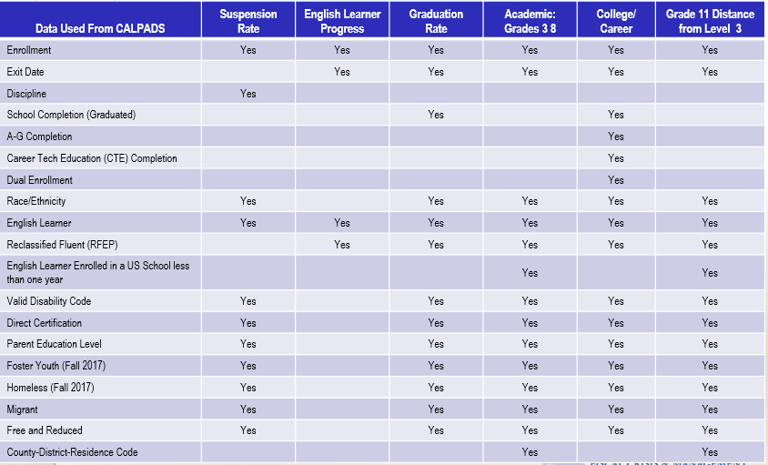
WHY DATA MATTERS!
CALPADS
data used for decision making!
Notes:
All data elements with a YES in the indicator column is pulled from CALPADS for the CA School Dashboard.

Slide 24
CALPADS reporting is critical to student identification across our state
Local Control Funding Formula (LCFF)
2013 - Governs school financing, provided for local decision-making, and measuring school progress broadly.
Every Student Succeeds Act (ESSA)
2015 – Reauthorization of the Elementary and Secondary Education Act (ESEA), replaced NCLB.
Provides for accountability and action to effect positive change in the lowest-performing schools.
No Child Left Behind (NCLB)
2002 - Put measures in place to expose achievement gaps among traditionally underserved students and their peers.
Notes:
One reason we submit data to CALPADS is to meet state and federal reporting requirements.
ESSA
Advances equity by upholding critical protections for America's disadvantaged and high-need students.
Requires—for the first time—that all students in America be taught to high academic standards that will prepare them to succeed in college and careers.
Ensures that vital information is provided to educators, families, students, and communities through annual statewide assessments that measure students' progress toward those high standards.
Helps to support and grow local innovations—including evidence-based and place-based interventions developed by local leaders and educators—consistent with our Investing in Innovation and Promise Neighborhoods
Sustains and expands this administration's historic investments in increasing access to high-quality preschool.
Maintains an expectation that there will be accountability and action to effect positive change in our lowest-performing schools, where groups of students are not making progress, and where graduation rates are low over extended periods of time.

Slide 25
What is LCFF & LCAP?
State Priorities &
CA School Dashboard
County Office Role
Differentiated Assistance
WHAT IS LCFF?
LCFF impact on
CA School Accountability
& Continuous Improvement

Slide 26
ACCOUNTABILITY & CONTINUOUS IMPROVEMENT
The Local Control Funding Formula (LCFF) is hallmark legislation that began in 2013-14. It fundamentally changed how all schools in the state are funded, how they are measured for results, and the services and supports they receive to allow all students to succeed to their greatest potential.
The new accountability system is based on
multiple measures, reflected in the state priorities,
that contribute to a quality education for all students.
Notes:
It allowed for a major shift in funding control into the hands of local school leaders.
The LCFF creates funding targets based on student characteristics (unduplicated student count) and provides greater flexibility (local control) to use these funds to improve student outcomes.

Slide 27
ACCOUNTABILITY & CONTINUOUS IMPROVEMENT
LCFF Unduplicated Pupil Count
collected each year on Census Day through data submitted to CALPADS
English Learners
Foster Youth
Students who qualify for free or reduced-priced meals

Slide 28
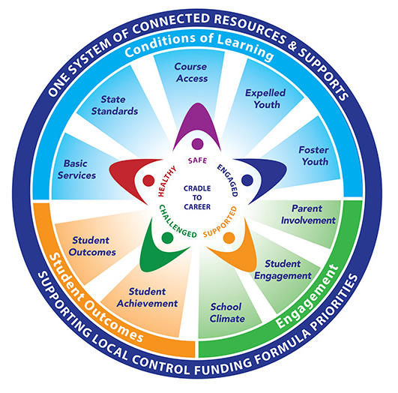
ACCOUNTABILITY & CONTINUOUS IMPROVEMENT
Whole Child Resource Map
Each ray in the circle represents one of the the state priorities of LCFF.
The star represents the whole child surrounded by those who want to ensure that ALL students are healthy, safe, engaged, challenged, and supported.
Notes:
This map provides Local Control Funding Formula (LCFF) priorities and whole child resources and supports to help local educational agencies, schools, and families serve the needs of the whole child.

Slide 29
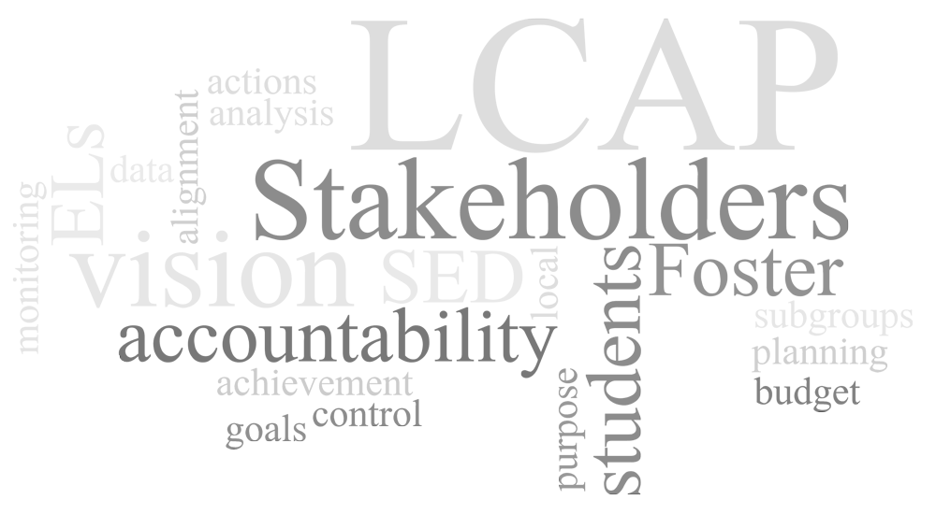
ACCOUNTABILITY & CONTINUOUS IMPROVEMENT
The Local Control Accountability Plan (LCAP)
provides an opportunity
for local educational agencies (LEAs)
to share their stories
of how, what, and why programs and services
are selected to meet their local needs.
LCAP is a critical part of LCFF. It is a 3-year plan that describes the goals, actions, services, and expenditures to support positive student outcomes that address state and local priorities.
Notes:
The Local Control Accountability Plan (LCAP) is a critical part of LCFF. It is a three-year plan that describes the goals, actions, services, and expenditures to support positive student outcomes that address state and local priorities.

Slide 30
ACCOUNTABILITY & CONTINUOUS IMPROVEMENT
STATE PRIORITIES
STATE INDICATORS
LOCAL INDICATORS
CONDITIONS OF LEARNING
Priority 1: Basic Conditions
Priority 2: State Standards
Priority 7: Course Access
Priority 9: Expelled Pupils (COEs only)
Priority 10: Foster Youth (COEs only)
*CA School Dashboard
*Addressed in LCAPs
College/Career Readiness
Basic Conditions at School
Implementation of State Standards
Coordination of Services for Expelled students & Foster Youth
ENGAGEMENT
Priority 3: Parent Involvement
Priority 5: Pupil Engagement
Priority 6: School Climate
Chronic Absenteeism
Graduation Rate
Suspension Rate
Parent Engagement
Local Climate Survey
(CA Healthy Kids Survey)
PUPIL OUTCOMES
Priority 4: Pupil Achievement
Priority 8: Other Pupil Outcomes
English Learner Progress
College/Career Readiness
Academics (CAASPP results)
Local measurement of student growth

Slide 31
ACCOUNTABILITY & CONTINUOUS IMPROVEMENT
The CA School Dashboard is a powerful online tool that displays the performance of local educational agencies (LEAs), schools, and student groups on a set of state and local measures to assist in identifying strengths, challenges, and areas in need of improvement.
State Indicators on the dashboard
Chronic Absenteeism
Suspension Rate
English Learner Progress
Grad Rate
College & Career
English Language Arts
Math
Notes:
Chronic Absenteeism Rate defined in California Code of Regulations Title 5, Section 157497.5 appendix:
(1) The number of pupils with a primary, secondary, or short-term enrollment during the academic year (July 1 – June 30) who are chronically absent where “chronic absentee” means a pupil who is absent 10 percent or more of the school days in the school year when the total number of days a pupil is absent is divided by the total number of days the pupil is enrolled and school was actually taught in the total number of days the pupil is enrolled and school was actually taught in the regular day schools of the district, exclusive of Saturdays and Sundays.
(2) The unduplicated count of pupils with a primary, secondary, or short-term enrollment during the academic year (July 1 – June 30).
(3) Divide (1) by (2).
Suspension Rate
Unduplication Number of Students Suspended in Current Year
divided by Cumulative Enrollment
Grad Rate
Number of Students Who Graduated
divided by Total Number of Students in the Graduating Cohort
CCI
Number of Graduates in the Current Year Class Who Performed "Prepared"
divided by Total Number of Students in the Current Year Class
*Multiple factors - Grade 11 CAASPP, AP Exams, IB Exams, College Credit, a–g Completion, State Seal of Biliteracy (New), Military Science/Leadership (New)
CAASPP ELA & Math
Sum of all distance from 3 (proficient) Scores on Summative Assessments
divided by Total Number of Summative Assessments Test Takers

Slide 32
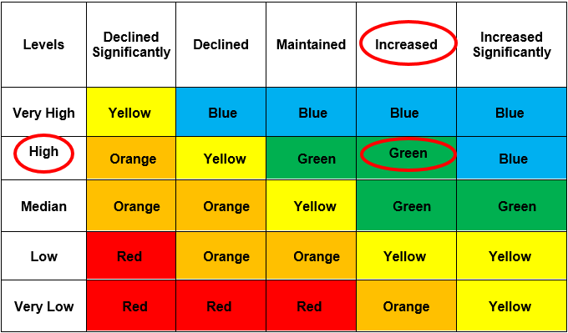
ACCOUNTABILITY
The dashboard reports
current performance
(STATUS)
AND
progress from the previous year
(CHANGE)
on a five-by-five colored table.
CHANGE
STATUS
State Indicators on the dashboard
Chronic Absenteeism
Suspension Rate
English Learner Progress
Grad Rate
College & Career
English Language Arts
Math

Slide 33
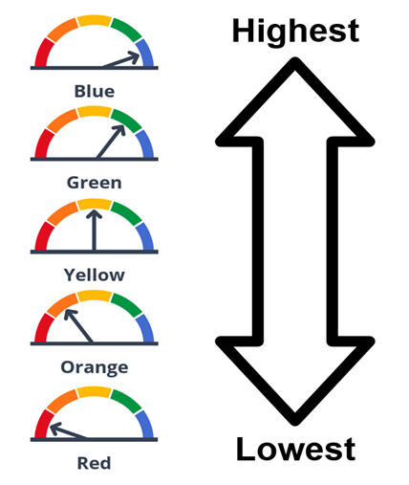
ACCOUNTABILITY & CONTINUOUS IMPROVEMENT
5 Performance Levels represented
by color gage
State Indicators on the dashboard
Chronic Absenteeism
Suspension Rate
English Learner Progress
Grad Rate
College & Career
English Language Arts
Math

Slide 34
ACCOUNTABILITY & CONTINUOUS IMPROVEMENT
Performance colors for the state indicators are assigned overall to all students and to each student group based on their status and change.
All Students
STUDENT GROUPS
English Learners
Foster Youth
Homeless
Socioeconomically Disadvantaged
Students w/ Disabilities
Race/Ethnicity
Notes:
Socioeconomically Disadvantaged (SED)
migrant, foster, homeless at any time during the academic year, or
eligible for Free or Reduced-Priced Meal (FRPM) Program (also known as the National School Lunch Program), or
direct certification for FRPM at any time during the academic year at the testing school, or
parent education level is marked as “both parents did not received a high school diploma” at the time of testing

Slide 35
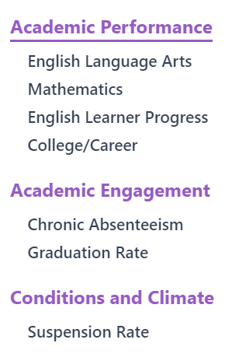
ACCOUNTABILITY & CONTINUOUS IMPROVEMENT
The data reported to CALPADS is reflected in the CA School Dashboard!
Notes:
All items checked are tracked through data submissions in CALPADS.

Slide 36
ACCOUNTABILITY & CONTINUOUS IMPROVEMENT
THREE LEVELS OF SUPPORT FOR LEAs & SCHOOLS
to promote continuous improvement & equity
SPI Intervention
Level 3
Intensive
Intervention
Provided by COEs
Level 2
Differentiated Assistance (DA)
Provided by COEs
Level 1
Supports for all
LEAs & Schools
Notes:
Level 1: goal is to provide all LEAs and schools with this assistance so that they do not require more intensive assistance. It is all about growth and equity. How can we get better?
The data included in the evaluation rubrics will highlight for LEAs and schools the indicators that require improvement LEA or schoolwide for specific student groups.
This level is all about being proactive not reactive
Level 2: LEA is eligible for differentiated support based on performance of the same student group(s) across the same LCFF priorities. This approach is consistent with a tiered approach to assistance.
This is a different level of support now because the LEA has failed to improve pupil achievement across more than one pupil subgroup. LEA is red in two or more priority areas (red or orange in priority area 4) indicated on the dashboard.
Most of the items that we have already discussed can be used to help a district at this point.
This is no longer proactive - it’s reactive.
Last year counties had approx. 25% of LEAs identified, as we move into this year we anticipate an increase as more indicators become live - we also know we’ll have some LEAs newly identified, some may be continuing into year 2 for same or different indicators
Level 3: 3 or more groups (red or orange priority 4) did not meet the performance criteria for 2 or more priorities in 3 out of 4 consecutive years
Superintendent of Public Instruction intervention

Slide 37
ACCOUNTABILITY & CONTINUOUS IMPROVEMENT
What is Differentiated Assistance?
The Statewide System of Support identifies Differentiated Assistance as an opportunity provided to eligible LEAs that have been shown to need attention in two or more priorities are represented with indicators on the Dashboard.
CONTINUOUS IMPROVEMENT
County offices will work jointly with districts in affirming and/or supporting focus areas of continuous improvement work that:
Builds capacity
Fosters collaboration
Builds a culture of co-learning and reflective inquiry
Promotes a climate of candor, evidence and urgency to take action
Results in improved student outcomes
Leads to sustainable change
Notes:
Continuous Improvement is a method dedicated to providing high quality, timely, and responsive resources and tools that are designed to assist all LEAs and their schools to meet the needs of each student served, with a focus on building capacity to sustain continuous improvement and effectively address inequities in student support and outcomes.

Slide 38
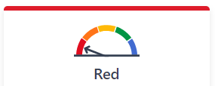
ACCOUNTABILITY & CONTINUOUS IMPROVEMENT
How are districts identified for Differentiated Assistance?
LEAs are eligible for assistance if the LEA "fails to improve pupil achievement across more than one state priority for
one or more student groups."
Notes:
Priority
1
Not Met for Two or More Years on Local Performance Indicator
BASICS
Priority
2
Not Met for Two or More Years on Local Performance Indicator
IMPLEMENTATION OF STATE ACADEMIC STANDARDS
Priority
3
Not Met for Two or More Years on Local Performance Indicator
PARENT ENGAGEMENT
Priority
4
Red on both English Language Arts and Math tests OR
Red on English Language Arts or Math test AND Orange on the other test OR
Red on the English Learner Progress Indicator (English learner student group only)
PUPIL ACHIEVEMENT
Priority
5
Red on Graduation Rate Indicator OR
Red on Chronic Absence Indicator
PUPIL ENGAGEMENT
Priority
6
Red on Suspension Rate Indicator OR
Not Met for Two or More Years on Local Performance Indicator
SCHOOL CLIMATE
Priority
7 & 8
Red on College/Career Indicator
ACCESS TO & OUTCOMES IN A BROAD COURSE OF STUDY
Priority
9
Not Met for Two or More Years on Local Performance Indicator
COORDINATION OF SERVICES FOR EXPELLED PUPILS (COEs ONLY)
Priority
10
Not Met for Two or More Years on Local Performance Indicator
COORDINATION OF SERVICES FOR FOSTER YOUTH (COEs ONLY)

Slide 39
Data Ethics
Data Security & Privacy
BEST PRACTICE
for accessing and using data ethically

Slide 40
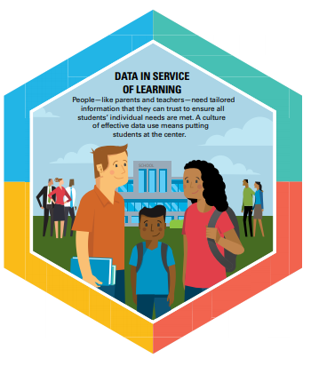
BEST PRACTICE
Foundations for Using Student Data
Student data should be used to further and support student learning and success.
Student data are most powerful when used for continuous improvement and personalizing student learning.
Student data should be used as a tool for informing, engaging, and empowering students, families, teachers, and school system leaders.
Students, families, and educators should have timely access to information collected about the student.
Student data should be used to inform, not to judge… and not replace the professional judgment of educators.

Slide 41
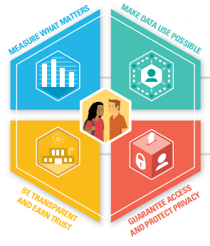
BEST PRACTICE
Foster a culture for using data
Fully integrate all privacy regulations into practices
Develop policies to share and protect data
Employ strong data security strategies
Be transparent about why and how you use data
Effective & Responsible Use of Student Data

Slide 42
BEST PRACTICE
A Positive Digital Culture
An environment in which technology is used in healthy and safe ways. All actors and stakeholders have an understanding of what behaviors and practices are appropriate to maintain this environment.
What does this environment look like?
Think about student safety on campus (in the physical world): Educators, staff, and administrators already have an understanding about when student information should and shouldn’t be disclosed, and what kind of behavior is appropriate
This kind of understanding shouldn’t be rejected in the digital world!
Privacy
The protection of personal information — practices we follow to ensure that data is only accessed by appropriate parties for appropriate uses (including designating permissions).
Security
Safeguards (which are usually technical) implemented to insure data is protected. (e.g. encryption, strong passwords, etc.)

Slide 43
BEST PRACTICE
This training should not be considered legal advice. If you have specific legal questions, they should be directed to your legal counsel. The purpose of this presentation is to give a general overview, to help you ask the right questions when consulting with your legal counsel.
The intent is to impart a basic understanding of what must be done to protect data privacy. Questions related to options for encryption and secure electronic transfer of data should be directed to your IT support.
There are MANY data privacy laws and statutes. While this presentation will highlight a few of them, you should consult legal counsel to determine the specific legal implications of any given situation.
*CDE slides reformatted for NCOE

Slide 44
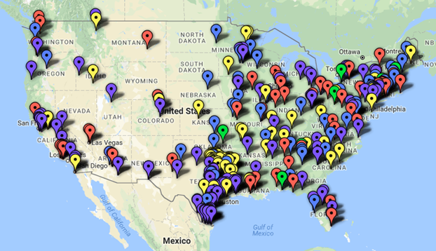
BEST PRACTICE
319
K-12 Cyber Attacks
Jan 2016 to March 2018
BLUE: phishing attacks
PURPLE: breaches or hacks resulting in the disclosure of personal data
YELLOW: ransomware attacks
GREEN: denial-of-service attacks
RED: other cyber incidents resulting in school disruptions & unauthorized disclosures
*CDE slides reformatted for NCOE
Notes:
Objective:
This map is an awesome visualization of the problem we face daily. As public education increasingly relies on technology for teaching, learning, assessment and state and federal reporting, it is imperative that effective policy and practice are in place to protect children and youth, school employees, and taxpayer-funded equipment and services.
FROM EDTECH Strategies- Why Was this map created?
1.to build a data-based awareness of the scope and variety of digital security and privacy threats facing K-12 public schools and districts
2.It also is intended to shed a light on the need for uniform standards for disclosing cyber incidents affecting schools, students, and educators.
Talking Points:
You have seen the headlines: Social Security numbers breached. Credit card numbers stolen. Email addresses accessed and misused. Data breach events affect thousands, hundreds of thousands, and sometimes millions of people. Most often, the data breaches making news are suffered by companies like Target and Home Depot, or colleges and universities and the U.S. Government. But local school districts are no less susceptible to data breaches than these high-profile entities. And they may face similar consequences: regulatory scrutiny, private lawsuits, and distrust of stakeholders like parents, students, teachers, or administrators
EXPLAIN: The K-12 Cyber Incident Map
•cybersecurity-related incidents reported about U.S. K-12 public schools and districts from 2016 to the present.**
•
‘Cyber’ incidents include:
phishing attacks resulting in the disclosure of personal data (blue pins);
other unauthorized disclosures, breaches or hacks resulting in the disclosure of personal data (purple pins);
ransomware attacks (yellow pins);
denial-of-service attacks (green pins); and
other cyber incidents resulting in school disruptions and unauthorized disclosures (red pins).
Twitter updates- follow @K12CyberMap

Slide 45
BEST PRACTICE
Snooping
Legitimate access but outside scope of responsibilities
Social Engineering
Techniques used to “trick” people into disclosing confidential info
Data release procedures/protocols
Follow written policies, maintain careful records
Faxing
Put procedures in place to safeguard confidential info
E-mail
Best practice is to avoid using email with personally identifiable info
Best practice is to upload sensitive information to a secure platform (ie OneDrive, Google Drive, DocTracking)
*CDE slides reformatted for NCOE

Slide 46
BEST PRACTICE
RESTRICTED ACCESS
“Legitimate Educational Interest”
AUTHORIZED PERSONNEL
ONLY
CALPADS user accounts are restricted to those currently employed school, district, or COE personnel or personnel contracted by LEA with a legitimate business need to input data, or access data in CALPADS.
Education Code Sections 49079.5 -.7 ,
CALPADS data are available and accessible to researchers
Education Code Section 49558 –
Provides some guidance and restrictions for interagency data sharing of school lunch information
Education Code Section 60607 –
Provides specific restrictions on the release of assessment data
FEDERAL
PROTECTIONS
ED CODE
NSLA
*CDE slides reformatted for NCOE
Notes:
HIPPA
Applies only to health information created or maintained by “health care providers” who engage in electronic transactions including health plans and health care clearinghouses
Records protected under FERPA and not subject to HIPAA (student health records, health related records in an IEP)
If record is from a health care provider not acting on behalf of a school and you are concerned as to whether HIPPA applies, check with legal counsel
PPRA –
Applies to programs and activities of LEAs receiving USDE funding
Governs the administration of surveys, analyses, or evaluations in one or more of eight protected areas
NSLA –
Governs the disclosures of information about a student’s free- or reduced-price meal status
If a student’s FRL eligibility status or the income information collected in order to determine the status is maintained as part of the student’s education record, FERPA disclosure rules apply in addition to NSLA guidelines
IDEA –
Federal legislation that ensures students with a disability are provided with Free Appropriate Public Education (FAPE) tailored to their individual needs
Throughout the IEP process, schools must protect the confidentiality of the student
COPPA –
Federal law governed by the Federal Trade Commission
Limits information collected from children under the age of 13
School districts are authorized to provide consent on parents’ behalf – information must be used for educational purposes only and not for any commercial use
LEAs should closely review the terms and conditions of websites and applications to ensure adherence with law
CIPA –
Federal law to address children’s access to obscene or harmful content on the web
LEAs that receive E-Rate funding must certify that they have an Internet safety policy that block or filter content that is obscene, child pornography, or harmful to minors; monitors minors’ online activities on the LEA network, and educates students about appropriate online behavior
Sample CIPA-Compliant Policy: Data Privacy Handbook
Objective:
State law makers knew the data would be key to be used for improving and quantifying public education in CA, so knowing the federal laws and in consideration of FERPA, we enacted Education Code whereby research and public policy can use the data.
Education Code (EC) Sections 49079.5 -.7
49079.5.
The Legislature recognizes that a longitudinal pupil data system provides direct and tangible benefits to pupils, educators, policymakers, and the public. The Legislature intends to make statewide longitudinal education data accessible to, and used to inform and engage, authorized stakeholders in an effort to support the continuous improvement of instruction, operations, management, and resource allocation, and in a manner that complies with all federal and state privacy laws. The Legislature intends to make statewide longitudinal education data available and accessible to researchers so they may evaluate the effectiveness of instructional materials, strategies, and approaches for educating different types of pupils in a manner that complies with federal and state privacy laws, including, but not limited to, the Family Educational Rights and Privacy Act of 2001 (20 U.S.C. Sec. 1232g) (FERPA). It is the intent of the Legislature, in enacting this section, to accomplish all of the following:
(a) Comply with the United States Constitution and all applicable federal laws, including FERPA and its implementing regulations (34 C.F.R. 99).
(b) Comply with the California Constitution and all applicable state laws and their implementing regulations, including, but not limited to, Section 1798.24 of the Civil Code.
(c) Further an environment in which the department and the California Longitudinal Pupil Achievement Data System (CALPADS) serve as resources for local educational agencies.
(d) Promote a culture of continuous improvement through collaboration and informed decision making at the classroom, school, district, state, and policymaker level.
(e) Minimize the anticipated workload increase on the department that may be generated by an increased number of data requests as CALPADS becomes operational, by establishing clear guidance on data access and an efficient process for responding to requests for access.
(f) Pursuant to FERPA and as defined in Section 1798.24 of the Civil Code, make pupil data available to qualified researchers from nonprofit organizations while appropriately protecting the privacy of individual pupils.
(Added by Stats. 2010, 5th Ex. Sess., Ch. 1, Sec. 4. (SB 2 5x) Effective April 12, 2010.)
49558. Related to NSLP data
(a) All applications and records concerning any individual made or kept by any public officer or agency in connection with the administration of any provision of this code relating to free or reduced-price meal eligibility shall be confidential, and may not be open to examination for any purpose not directly connected with the administration of any free or reduced-price meal program, or any investigation, prosecution, or criminal or civil proceeding conducted in connection with the administration of any free or reduced-price meal program.
Ed Code Section 60607
Provides specific restrictions on the release of assessment data
restrictions greatly limit access to this data without parental consent
60607. Assessment Information is NOT directory information, so there had to be education code related to how and when Assessment data can be shared.
(a) Each pupil shall have an individual record of accomplishment by the end of grade 12 that includes the results of the achievement test required and administered annually as part of the California Assessment of Student Performance and Progress (CAASPP), or any predecessor assessments, established pursuant to Article 4 (commencing with Section 60640), results of end-of-course examinations he or she has taken, and the vocational education certification examinations he or she chose to take.
(b) It is the intent of the Legislature that local educational agencies and schools use the results of the academic achievement tests administered annually as part of the CAASPP to provide support to pupils and parents or guardians in order to assist pupils in strengthening their development as learners, and thereby to improve their academic achievement and performance in subsequent assessments.
(c) (1) Except for research provided for in former Section 49079.6, as it read on December 31, 2013, a pupil’s results or a record of accomplishment shall be private, and may not be released to any person, other than the pupil’s parent or guardian and a teacher, counselor, or administrator directly involved with the pupil, without the express written consent of either the parent or guardian of the pupil if the pupil is a minor, or the pupil if the pupil has reached the age of majority or is emancipated.
(2) (A) Notwithstanding paragraph (1), a pupil or his or her parent or guardian may authorize the release of pupil results or a record of accomplishment to a postsecondary educational institution for the purpose of credit, placement, or admission.
(B) Notwithstanding paragraph (1), the results of an individual pupil on the CAASPP may be released to a postsecondary educational institution for the purpose of credit, placement, or admission.
(Amended by Stats. 2014, Ch. 327, Sec. 19. (AB 1599) Effective January 1, 2015. Inoperative July 1, 2020. Repealed as of January 1, 2021, pursuant to Section 60601.)

Slide 47
BEST PRACTICE
Believe it or not, it isn’t always the BIG data breaches,
but instead just lack of attention or human error.
Some examples we commonly see:
Sending attachments of raw data via email
Screenshot of CALPADS/SIS information and emailing it
Saving extracts of massive amounts of raw data to a public folder
Leaving printed CALPADS detail reports on your desk
Allowing a student to work at the desk with an active CALPADS session
Sharing userID/Passwords
*CDE slides reformatted for NCOE
Notes:
Student Privacy and Data Collection the recommendations from the Attorney General:
In the midst of so many laws, both federal and state mandates, the attorney for the State of CA only recommends these “common sense” approaches to student data.
Source: Ready for School (Issued Nov. 2016 by California Attorney General’s Office) : Recommendations for the Ed Tech Industry to Protect the Privacy of Student Data

Slide 48
BEST PRACTICE
Data Collection & Retention
Minimization is the goal
Data Use
Keep it educational
Data Disclosure
Make protections stick
sit amet at nec at adipiscing
These are the types of precautions we take daily,
and following these common sense recommendations can
go a long way in our obligation to protect student data.
Individual Control
Respect users’ rights
amet at nec at adipiscing
Data Security
Implement reasonable &
appropriate safeguards
amet at nec at adipiscing
Transparency
Provide a meaningful
privacy policy
amet at nec at adipiscing
*CDE slides reformatted for NCOE
Notes:
Student Privacy and Data Collection the recommendations from the Attorney General:
In the midst of so many laws, both federal and state mandates, the attorney for the State of CA only recommends these “common sense” approaches to student data.
Source: Ready for School (Issued Nov. 2016 by California Attorney General’s Office) : Recommendations for the Ed Tech Industry to Protect the Privacy of Student Data

Slide 49
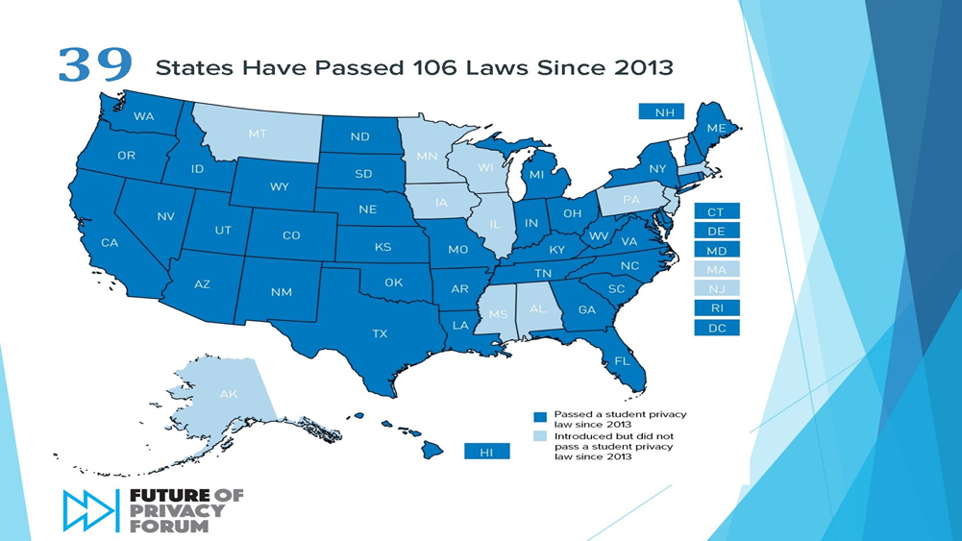
BEST PRACTICE
*CDE slides reformatted for NCOE
Notes:
Objective:
Introduce the two tier system of state and federal applicable laws; demonstrate the severity of the problem nationwide with a state response.
We all hear people talk about data breaches and privacy laws, but here is a visual of how prevalent the response has been.
Since 2013, 39 states have introduced or passed laws specific to Student Data Privacy. All the others have introduced and discussed student data privacy, except Vermont, at least as described on this map.
With the massive amount of data we collect on each student in the US, this repository is attractive to criminals. These students likely would not know their information was violated until later, when they look for credit or apply for jobs and the unauthorized usage of their Personal identity information becomes apparent. These data are at a great value because these students don’t monitor their information the same was adults do.

Slide 50
Next Steps...
Resources & Additional Support
Survey
WRAP-UP

Slide 51
LET’S LOGIN!
Login: www.calpads.org
Navigation
Role Specific Report Access
User settings and Password

Slide 52
OH NO! Hold tight...
CALPADS Glitches
During high frequency enrollment period for sites and/or submission deadlines
System closures during holidays, major system updates and data pulls
Daily protocols should be evaluated to ensure data quality during this time

Slide 53
DATA PRIVACY RESOURCES
Data Privacy Guidebook | Summary of relevant laws and CA ed code, includes sample policies, assessments, and data breach protocols | Collaborative project between CSESSA, CETPA, and Fagen Friedman & Fulfrost LLP. | http://www.f3law.com/downloads/COMPLETE%20Privacy%20Guidebook%2009_18_15.pdf
California Student Privacy Alliance | Searchable database of AB1584 compliant education applications | Partnership with CETPA, Ventura COE, Access 4 Learning Community's Student Data Privacy Consortium and the Massachusetts Student Privacy Alliance (MSPA). | https://secure2.cpsd.us/cspa/agreement_info.php
Access 4 Learning | Collaborative to collectively address all aspects of learning information management and access to support learning. | Non-profit collaboration of schools, districts, local authorities, states, US and International Ministries of Education, software vendors and consultants | https://www.a4l.org/
Future of Privacy Forum | FERPA/SHERPA , Educator’s Guide to Student Privacy, resources for parents | Think tank and advocacy group focused on issues of data privacy | https://fpf.org
iKeepSafe | FERPA, COPPA, and CSDPA-certified compliant products | Certifies technology used by children and in educational settings with qualified experts | https://ikeepsafe.org/
Common Sense Media | Family guides, research, concerns (e.g. cyberbullying, trolls, social media) | Nonprofit dedicated to helping kids thrive in a world of media and technology | https://www.commonsensemedia.org/
*CDE slides reformatted for NCOE

Slide 54
RESOURCES & SUPPORT
https://www.cde.ca.gov/ds/sp/cl/
https://csis.fcmat.org/resources
https://documentation.calpads.org/Support/References
https://www.youtube.com/channel/UCA9oRTiyVECCCzOxpmJheZw
http://www2.cde.ca.gov/calpadshelp/default.aspx (include Job ID and Error #)
calpads-support@cde.ca.gov (include Job ID and Error #)
https://csis.fcmat.org/ListServ
CALPADS Info Meeting Fall 2019
PowerPoint slide deck
Resources from CDE/Flash Updates
Flash #158 Gender and Legal Name
Flash #159 Restraint & Seclusion
Flash #160 District of Special Ed Accountability
Flash #161 Special Education in CALPADS
Flash #163 English Learner Programs
Padlet for Assignment Monitoring, New Course Codes
CA School Dashboard
CCSESA Differentiated Assistance
Facilitation Guide - 2nd Edition
Notes:
California Department of Education
LCFF Priorities/Whole Child Resource MAP
Local Control Funding Formula
State Priority Related Resources
CALPADS and Data Privacy
Local Control Accountability Plan

Slide 55
QUICK SURVEY
Napa County Data Network - Spring 2019 Survey
Link available above, email or event invite

Slide 56
Thank You!
For your willingness + capacity to learn!

Slide 57
Request more support!
ALEX ANDARY
Coordinator of Data + Analytics
Department of Continuous Improvement
Napa County Office of Education
aandary@napacoe.org | (707) 259-5981

